Slide 1
Cupernham Junior School
Puberty resource share
Reminder
Learning about puberty is statutory for all children.
This PowerPoint is intended to inform parents/carers of the resources we will be using to teach puberty and allow parents/carers to continue these conversations at home if they wish.

Slide 2
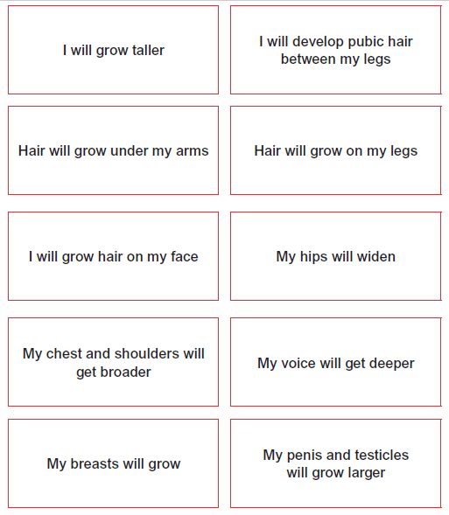
We will talk about the changes which our bodies will go through during puberty and sort into male, female or both.

Slide 3
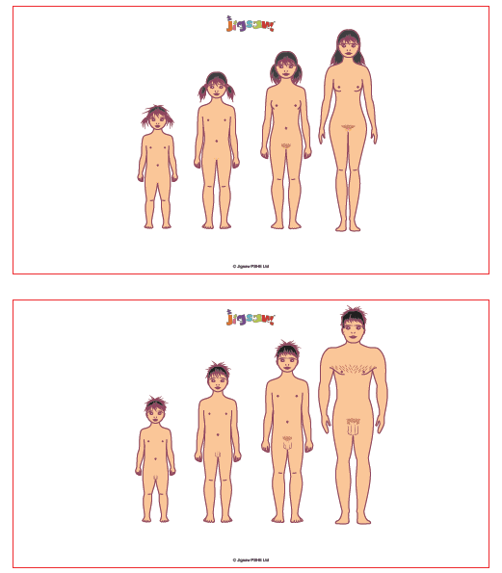
We will look at physical changes which happen to the outsides of our bodies.

Slide 4
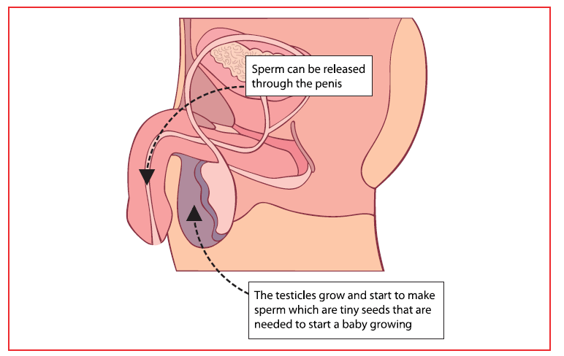
We will talk about the changes which our bodies will go through on the inside too.

Slide 5
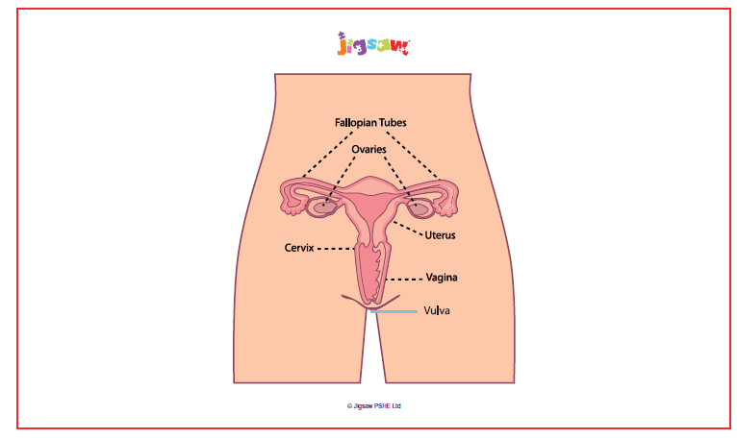
We will talk about the changes which our bodies will go through on the inside too.

Slide 6
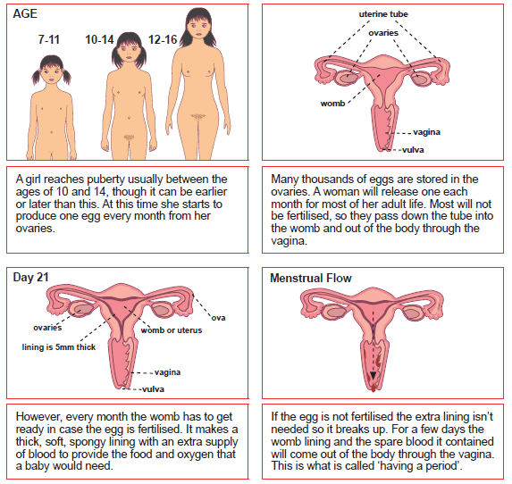
This will include the
Menstruation process.

Slide 7
Teaching of puberty sessions.
The children will be shown the male and female changes as a whole class, and then be given time in split groups (boys and girls) to further discuss changes which will happen to them and to answer any questions they have.
These questions will be written anonymously for the teacher to answer. They will be checked for appropriateness beforehand.

