Slide 1
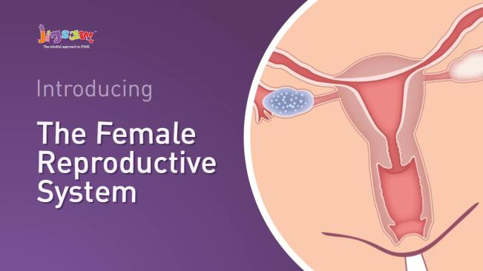
We will use the following animation which the teachers will explain verbally.

