Slide 1
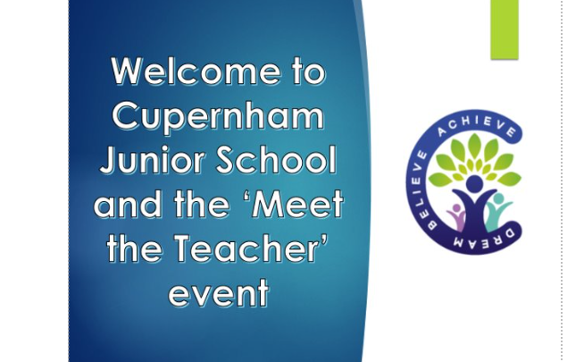


Slide 2
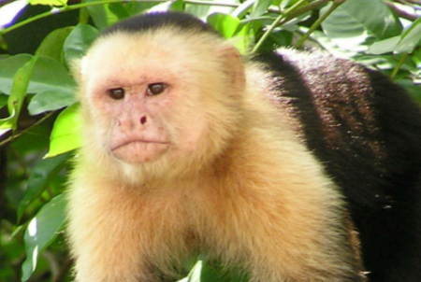
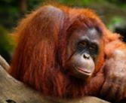
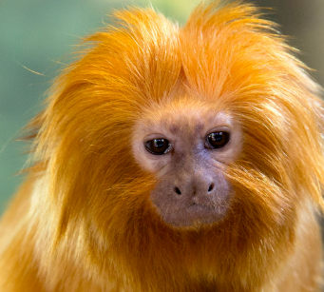
Welcome to Year 5
Teachers
Capuchins – Miss Dowling A.k.a Ms Osborne
Orangutans-Miss Harwood
Tamarins-Miss Humby

Slide 3
Welcome to Year 5
Learning Support Assistants
Capuchins – Mrs Liney
Orangutans-Mrs Reuberson
Tamarins-Mrs Nicholls

Slide 4
Topics
Shake, Rattle and Roll- Geography
Terrible Tudors! – History - Henry VIII + Shakespeare’s Macbeth
Space Explorers – Science focus
A Civilised Bunch –History (Early Ancient Civilisations – Focus Ancient Egyptians
Energy Emergency-Geography
Eureka-History (Ancient Egyptians)

Slide 5
Year Group Timetable

Slide 6
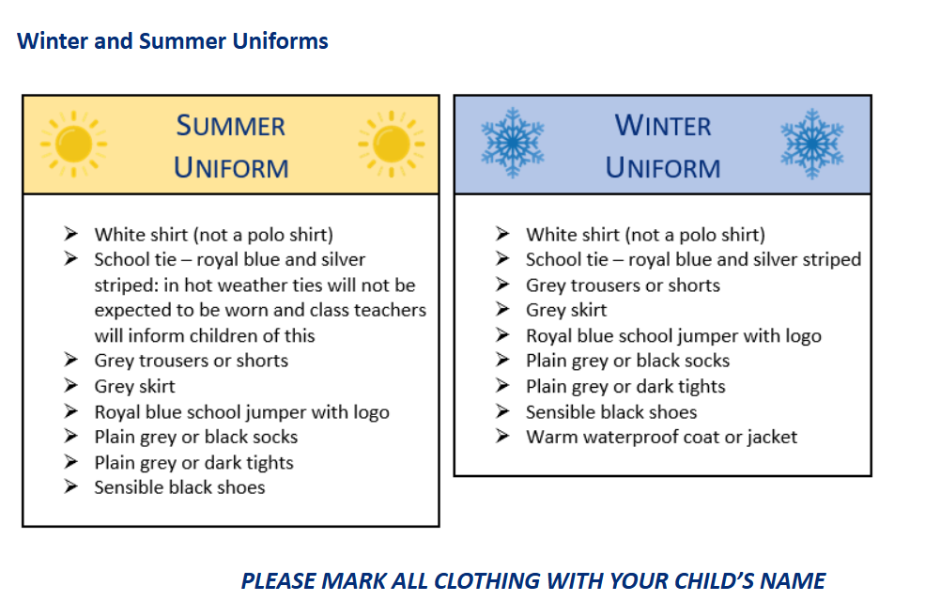
Uniform

Slide 7
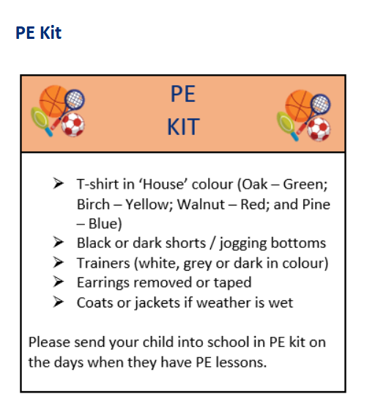

Slide 8


Home Learning
Every Monday Maths homework will sent home. Children need to choose either A,B or C to complete. A is the equivalent of M1 in class.
The Maths homework should take no more than half an hour.
Spellings will be set on a Monday and tested on the following Monday. Practise should be three times a week for 10-15minutes.
Your child needs to read daily to build stamina.
Please record that they have completed the above on the Boom Reader App. These will be checked regularly by class teachers.

Slide 9




Notes:
Reading at Cupernham – is incredibly important, something we value and something we want our children to value and enjoy.

Slide 10

Now
The future
Throughout the Autumn term, we will be exploring what other reading schemes and platforms are out there.
More information to be shared with parents in due course, including any log in details, colour bands, etc. as appropriate
Notes:
We still currently use Accelerated Reader as a reading platform – Years 4, 5 and 6, you’ll be familiar with this and the quizzes children can take.
Whilst Accelerated Reader offers lots to the children and to us, it is not without its drawbacks and complications.
We are therefore, throughout the Autumn term, going to be exploring what other reading schemes and platforms there are, to ensure the children have access to the best.
Once we’ve gone through this process, all relevant information will be shared with parents in due course, including any logins, bands / colours, etc. as appropriate. Watch this space!

Slide 11
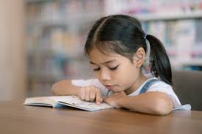
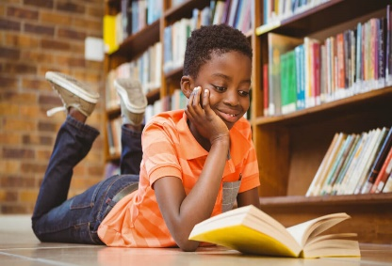
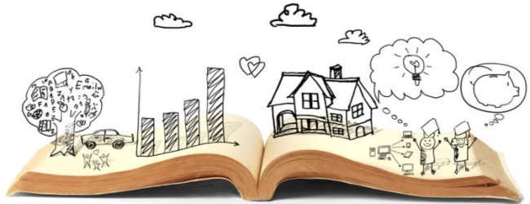
Grapple and Enjoyment
Children will be assessed in the next week or two to determine their current reading level / reading age
The ‘Grapple’ book is one based on each child’s reading level.
These books help improve a child’s decoding, fluency and comprehension. It will help develop the skills needed to become a competent reader.
For some, this will be a colour banded book.
The ‘Enjoyment’ book – as the name suggests – is for the children to enjoy! This may be a non-fiction book based on interests, a picture book, a comic, poetry or another chapter book they like the look of.
We believe it’s important that our children learn to read and learn to love reading.

Slide 12

Our digital reading record – available as an app or online.
Please use this to record your child’s reading (or get them to record their own).
We use this to help calculate Golden Tickets, with one golden ticket earnt for every 10 times a child reads: the more they read, the more golden tickets they earn.
At the end of each half-term, we have our Golden Ticket prize draw, where children can win books to keep and bookmarks.
Notes:
BOOM Reader!
App or online – please contact the office if you need any help with logins etc.
Links to golden tickets and half-termly draws

Slide 13


Internet Safety
We discuss internet safety regularly in school but it is important the conversation is continued at home too.
Please be aware of the following age restrictions:
Use of social media
Facebook – 13
Instagram – 13
Snapchat – 13
WhatsApp - 16
You Tube - 13
If your child uses these platforms, you as the parent, are responsible for any content posted or downloaded as they are using them against the terms of the sites.
Mobile phones:
Children do not need these in school
If they bring a phone into school, it will be locked in the teachers’ cupboard

Slide 14
Enrichment
Our proposed enrichment activities:
Fairthorne Manor 1 night residential -9- 10th October 2025
INTECH Winchester science centre-Thursday 27th November - £
Romsey Abbey Christmas Concert – Thursday 11th December Afternoon performance
Hampton Court – Kingston (Spring1) - £TBC
Maz Evans-author visit in school - £4 donation
Class Assemblies – 2.45pm
Tamarins – 11th June 2026
Organgutans – 4th December 2025
Capuchins – 5th March 2025

Slide 15
Communication
If you need to contact your child’s teacher, please send an email via the school office and will endeavour to back to you within 24 hours.
Alternatively, write us a note in your child’s home learning book, which must be in school everyday.
Please be assured we will contact you urgently if we have any concerns about your child.

Slide 16

A fantastic year!
The children have all made a brilliant start to Year 5 and we are delighted with how well they have settled. We would like to thank you for your ongoing support at home.
We have some really exciting topics to cover this year and we are sure that they will all have an enjoyable and engaging time in year 5.

