Slide 1



Slide 2
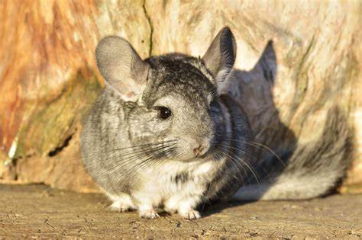
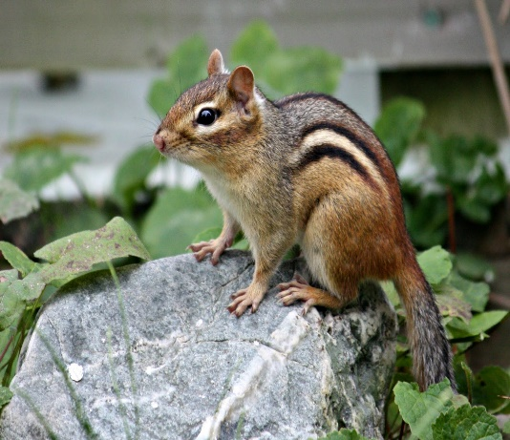
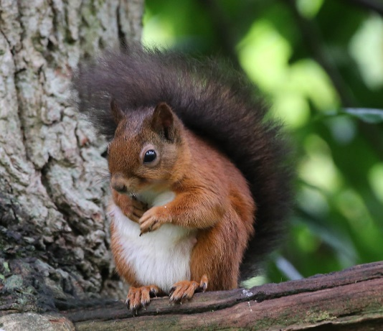
Welcome to Year 4!
Chinchillas – Miss Keem
Chipmunks – Miss Humby
Squirrels – Mrs Jewell & Mrs Reilly (Friday)
Our learning will be supported by Mrs Wright, Mrs Brannetti
and Mrs Williams (LSAs)

Slide 3
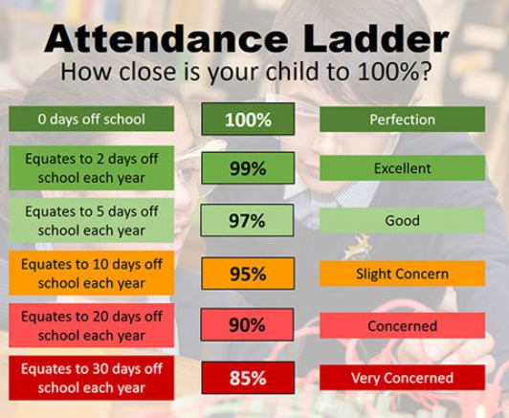
Good Attendance = Belonging
School will expect parents to ensure that their child attends school, is punctual for registration (8.50am) and that all absences are confirmed by telephone every morning by 9am.

Slide 4
Year 4 Topics
Fire & Fangs.
Arctic Adventures.
Scots & Saxons.
Climate Zones & Biomes.
Vicious Vikings.
Plastic… Fantastic?

Slide 5
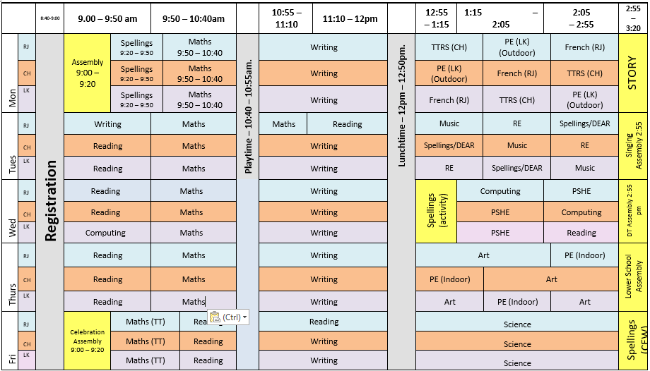
A typical week in Year 4…

Slide 6
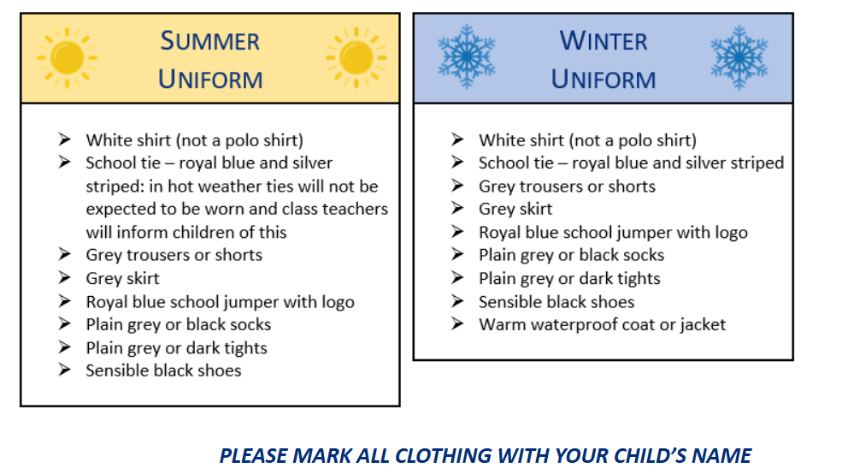
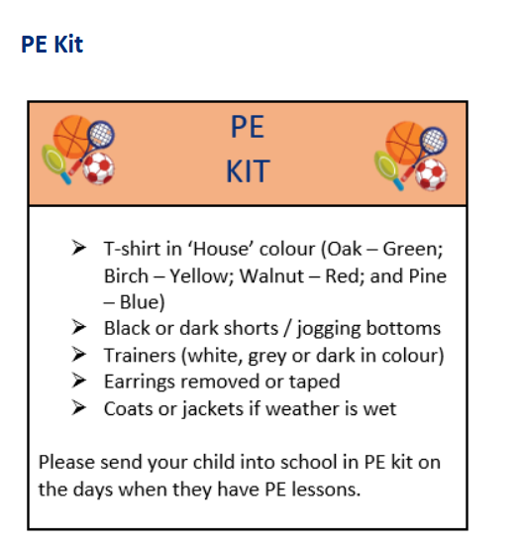
Uniform
We will be really emphasising the importance of wearing the correct uniform in Year 4, as the children’s next step is to move into Upper School.
Year 4 PE days are MONDAY (outdoor) and THURSDAY (indoor). Please send your child in wearing their PE kit on these days.
Please make sure your child also has an appropriate coat in school for the cold and wet days as we will still be going outside as much as possible.
They also need a water bottle in school everyday.

Slide 7
Jewellery and Hair
To adhere to health and safety guidelines, children who have their ears pierced should only be wearing studs in school. No other earring types should be worn as they represent a risk. During PE lessons, children need to be able to take out their studs and put them back in at the end of the lessons. If they are unable to do so, they will need to put tape over the studs.
No other jewellery should be worn at school unless it is of a religious or medical significance. Please inform your child’s teacher if this is the case.
All children with long hair should wear it tied or clipped back for school. This is, again, to adhere to health and safety guidance and to prevent any possible spread of head lice. Any hair accessories should be discreet and minimal. Extreme hair styles (dyed hair, tramlines, Mohicans etc.) are not permitted.

Slide 8


Home Learning
At the beginning of the term, your child will be given their spellings for the whole term. These will be dated for each week and will be tested every Monday.
We recommend practising 3 x a week for 15 mins.
This year, our Maths homework each week will be TT Rockstars practise. Your child’s teacher will monitor the completion of this each Monday.

Slide 9
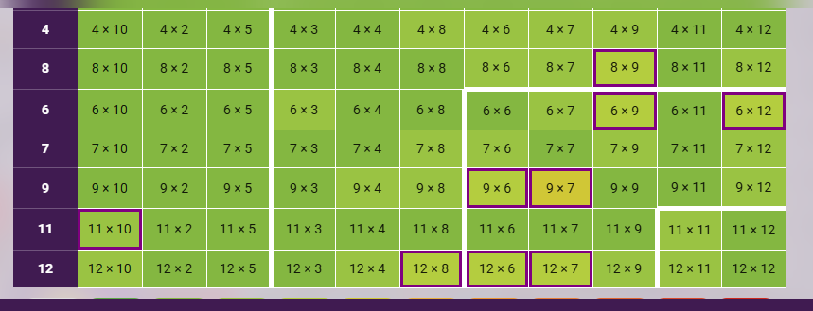
TTRS
Garage – Please talk about the questions your children will be asked before they start!

Slide 10
Home Learning
We also encourage children to complete daily reading. If this is recorded on Boom Reader, they will earn Golden Tickets and will be given the chance to win a book from the vending machine or a bookmark.
If you are able to support the school with listening to readers, or offer your time in any way, please contact the office and they will forward your information to class teachers.

Slide 11

Our digital reading record – available as an app or online.
Please use this to record your child’s reading (or get them to record their own).
We use this to help calculate Golden Tickets, with one golden ticket earnt for every 10 times a child reads: the more they read, the more golden tickets they earn.
At the end of each half-term, we have our Golden Ticket prize draw, where children can win books to keep and bookmarks.
Notes:
BOOM Reader!
App or online – please contact the office if you need any help with logins etc.
Links to golden tickets and half-termly draws

Slide 12


Notes:
Reading at Cupernham – is incredibly important, something we value and something we want our children to value and enjoy.

Slide 13

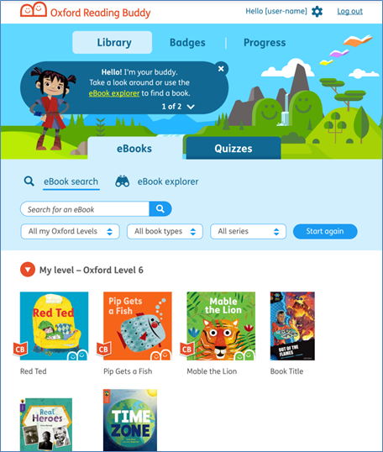

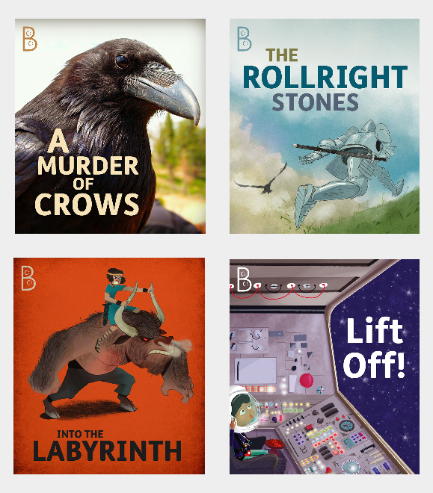
Oxford Reading Scheme
Notes:
Oxford Reading Tree will soon become our new reading scheme for the school, with new books colour banded at different reading levels for children to read, enjoy and progress with.
Oxford Reading offers an online platform with access to both physical books and e-books online as well as an online Reading Buddy through the Oxford Reading Tree website, which supports the children with their fluency, decoding and understanding of texts.
There are quizzes for many of their books too so opportunities for children to earn rewards for their reading avatar.
We’re just in the process of setting this up fully with new books arriving. Once the scheme is ready to be launched in full, we’ll send out more communication and Ms Dowling, our Reading Lead, will look to arrange some parent workshops to talk this through in more detail.

Slide 14
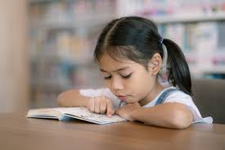


Grapple and Enjoyment
Children will be assessed in the next few weeks to determine their current reading level / reading age
The ‘Grapple’ book is one based on each child’s reading level.
These books help improve a child’s decoding, fluency and comprehension. It will help develop the skills needed to become a competent reader.
For some, this will be a colour banded book.
The ‘Enjoyment’ book – as the name suggests – is for the children to enjoy! This may be a non-fiction book based on interests, a picture book, a comic, poetry or another chapter book they like the look of.
We believe it’s important that our children learn to read and learn to love reading.

Slide 15

Trips
We are already planning lots of exciting activities for the year…
Winchester Cathedral to begin our Saxon topic – Thursday 14th January
Zoolab to support our Climate Zones and Biomes topic – Spring 2 - Date TBC
Viking Day – Thursday 22nd April (Dress up)
and of course….
Year 4 camp – Thursday 1st July – Friday 2nd July
Class Assemblies
Chinchillas – Thursday 21st January
Squirrels – Thursday 29th April
Chipmunks - Thursday 6th May

Slide 16
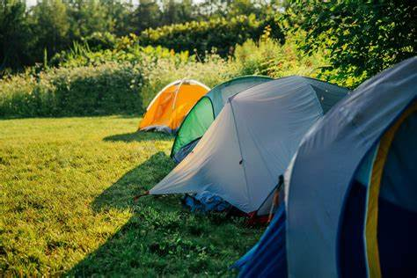
Year 4 Camp!
In the Summer Term, the children in Year 4 are given the opportunity to experience a night away from home and camp out on the school field!
The children receive the full camping experience, even putting the tents up themselves, before enjoying a wide range of campsite activities, a shared dinner in the hall and a very special Cupernham Talent Show in the evening!
Year 4 Camp is the perfect opportunity for children to experience a night away from home and it helps to get children ready for external residentials in Year 5 and 6.

Slide 17
Communication
If you need to contact your child’s teacher, please send an email via the school office. We will endeavour to reply as soon as possible, but please be aware if you send a message outside of working hours, it may not be replied to until the following working day.
Alternatively, write us a note to be handed to us in the morning. We will be happy to help.
Please be assured we will contact you if we have any concerns about your child.

Slide 18
Safe Collection
Please be aware of the revised collection procedures. These match the email and Microsoft form that you have received.
YEAR 3:
ALL children to be collected by a named adult. No child will be allowed to walk and meet their adult.
YEAR 4:
Parental option for child to walk to designated meeting point on site. Children cannot walk home alone. Parental option for an older sibling to walk home with child.
YEARS 5 and 6:
Parental option for children to walk home alone.
Please ensure that any changes to the submitted form are shared with the school office so that permissions can be updated.

Slide 19

Smartphone and Smart-Device Free School
As a reminder, we are a smartphone and smart-device free school.
Help us work together so that all adults are modelling smartphone free behaviour whilst on school site.

Slide 20

Internet Safety
We discuss internet safety regularly in school but it is important the conversation is continued at home too.
Please be aware of the following age restrictions:
Use of social media
Facebook – 13
Instagram – 13
Snapchat – 13
WhatsApp - 13
You Tube – 13
TikTok - 13
If your child uses these platforms, you as the parent, are responsible for any content posted or downloaded as they are using them against the terms of the sites.

Slide 21
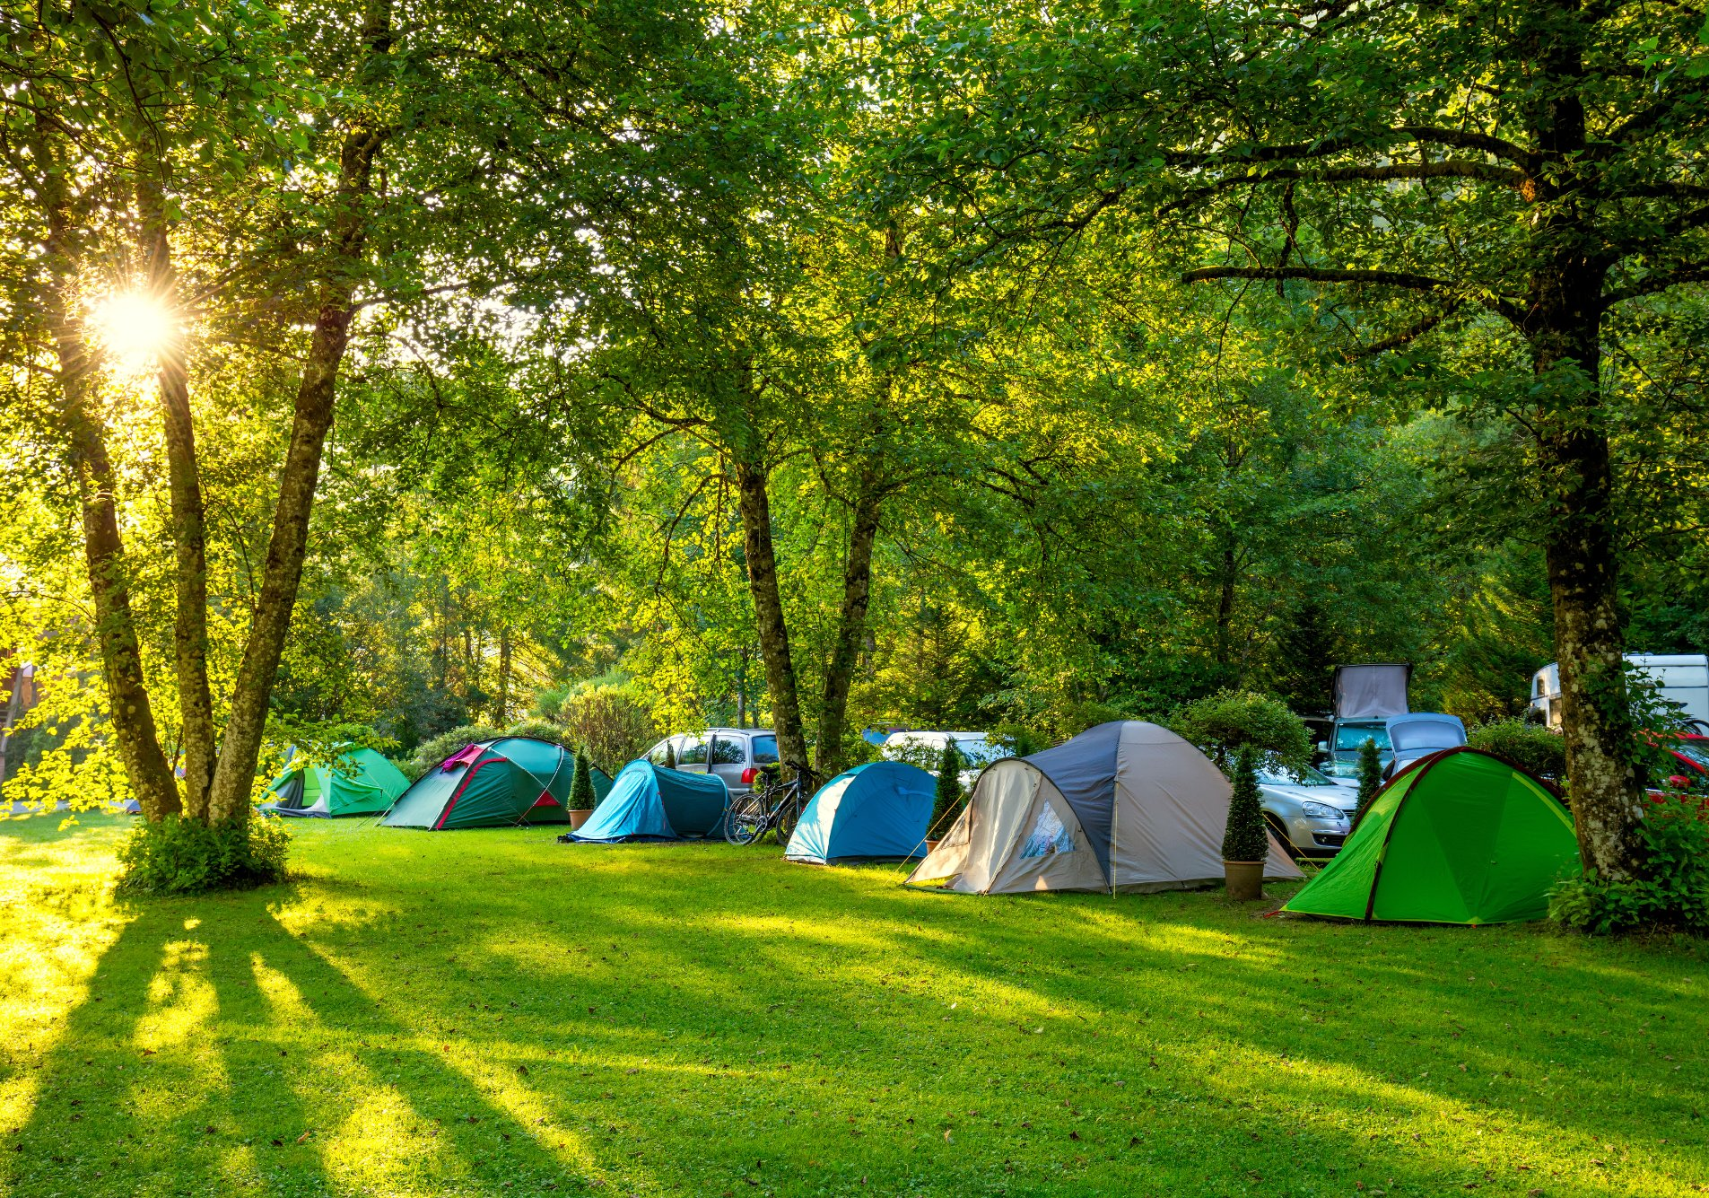
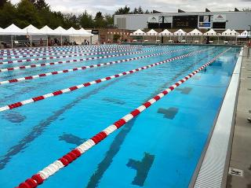
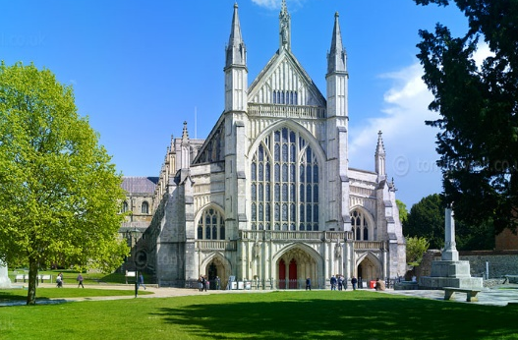
Here’s to a fantastic year ahead!
The children have all made a brilliant start to life in Year 4 and we are delighted with how well they have settled.
We have some really exciting trips and topics coming up this year and we are sure that the children will all have a fantastic year!

Slide 22
Any Questions?
Please come and see the classrooms and introduce yourselves.
Thank you for coming!

