Slide 1



Slide 2
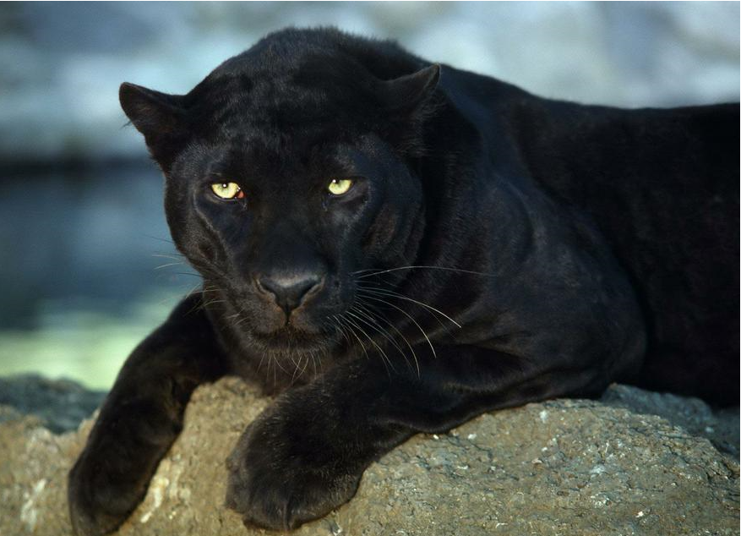
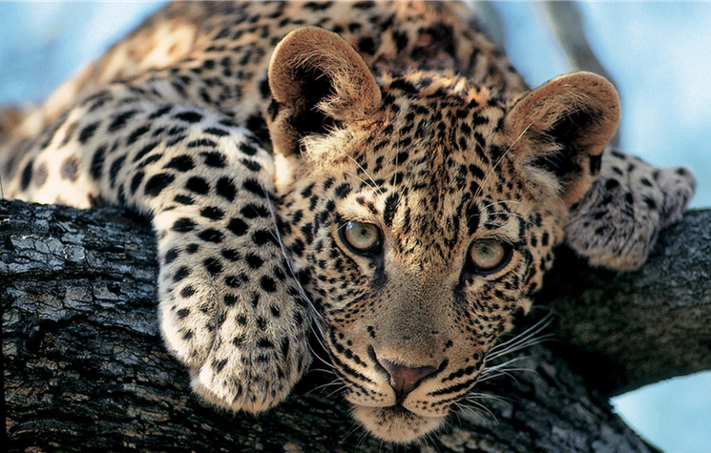
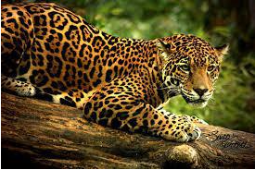
Welcome to Year 6!
Panthers Leopards Jaguars
Mrs Allen Ms Dowling Mrs Poonia
Mrs Reuberson Mrs Gibbs
Miss Kershaw

Slide 3
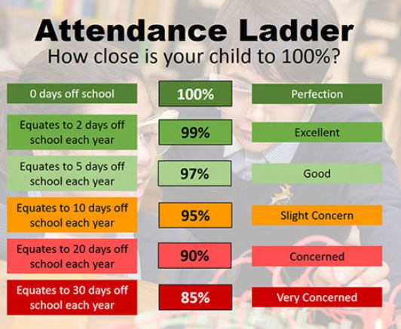
Good Attendance = Belonging
School will expect parents to ensure that their child attends school, is punctual for registration (8.50am) and that all absences are confirmed by telephone every morning by 9am.

Slide 4
Topics
Fantastic Florida (Geography)
Road to Baghdad (History)
Survival of the Fittest (Science)
The Spitfire Coast (History)
The Curse of Curiosity (English-writing)
From Here to There (Geography)

Slide 5
Home Learning
Every Monday spellings and a Maths homework will be set. It is due in by the following Monday.
The Maths homework should take no more than half an hour. It will be the same format as last year with a choice of 3 different levels. After Christmas, this will be replaced by SATs revision guides that we will provide.
Spelling practise should be three times a week for 10-15 minutes.
Your child needs to read daily, where possible with an adult, to build stamina. The adult can then question what has been read, explore the vocabulary together and wonder what might happen next! What if they were to add a character in? How would they draw the setting or the character? What synonyms / antonyms can they find for known / unknown words?

Slide 6
Safe Collection
Please be aware of the revised collection procedures. These match the email and Microsoft form that you have received.
YEAR 3:
ALL children to be collected by a named adult. No child will be allowed to walk and meet their adult.
YEAR 4:
Parental option for child to walk to designated meeting point on site. Children cannot walk home alone. Parental option for an older sibling to walk home with child.
YEARS 5 and 6:
Parental option for children to walk home alone.
Please ensure that any changes to the submitted form are shared with the school office so that permissions can be updated.

Slide 7

Smartphone and Smart-Device Free School
As a reminder, we are a smartphone and smart-device free school.
Help us work together so that all adults are modelling smartphone free behaviour whilst on school site.

Slide 8
Internet Safety
Throughout the year, we will discuss internet safety regularly in school but it is important the conversation is continued at home too.
Please be aware of the following age restrictions when using social media:
Facebook – 13
Instagram – 13
Snapchat – 13
You Tube - 13
Tik Tok - 13
WhatsApp - 13
If your child uses these platforms, you as a parent are responsible for any content posted or downloaded as they are using them against the terms of the sites.
Notes:
Sarah

Slide 9


Notes:
Reading at Cupernham – is incredibly important, something we value and something we want our children to value and enjoy.

Slide 10
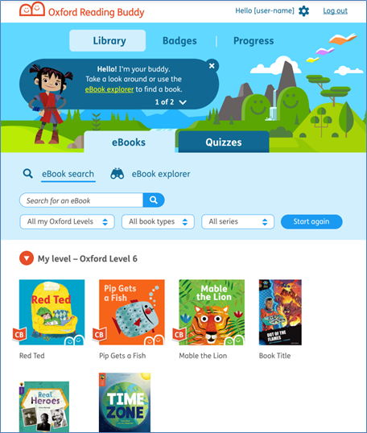
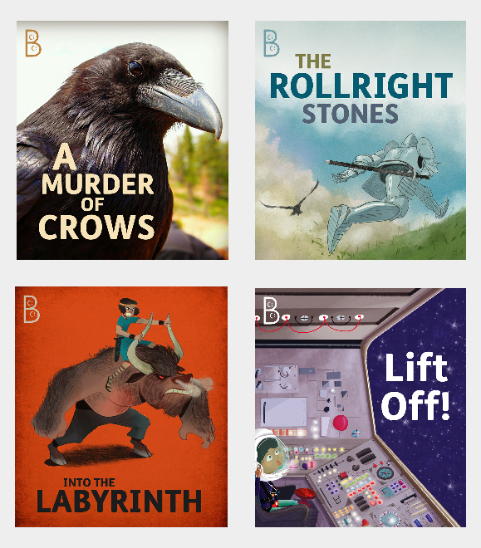
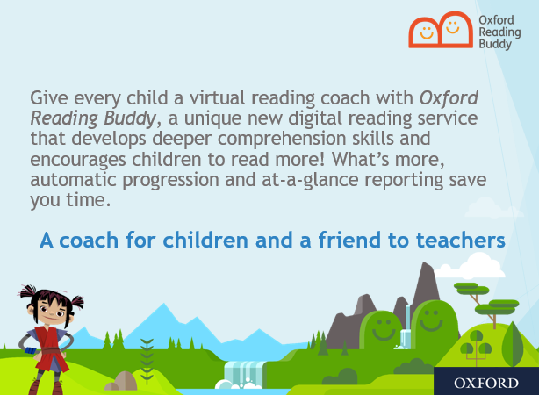

Oxford Reading Scheme
Notes:
Oxford Reading Tree will soon become our new reading scheme for the school, with new books colour banded at different reading levels for children to read, enjoy and progress with.
Oxford Reading offers an online platform with access to both physical books and e-books online as well as an online Reading Buddy through the Oxford Reading Tree website, which supports the children with their fluency, decoding and understanding of texts.
There are quizzes for many of their books too so opportunities for children to earn rewards for their reading avatar.
We’re just in the process of setting this up fully with new books arriving. Once the scheme is ready to be launched in full, we’ll send out more communication and Ms Dowling, our Reading Lead, will look to arrange some parent workshops to talk this through in more detail.

Slide 11
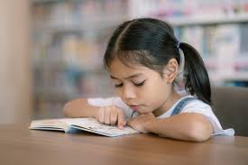
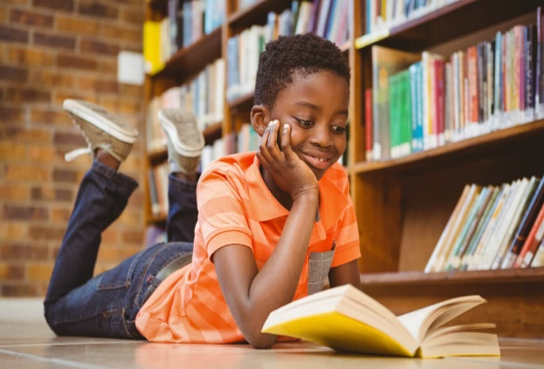
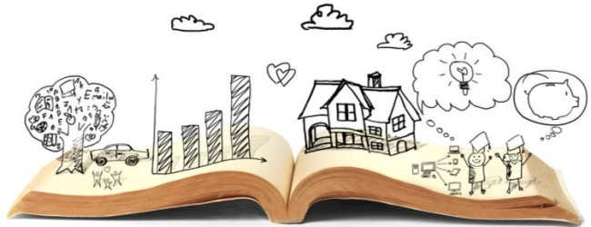
Grapple and Enjoyment
Children will be assessed in the next week or two to determine their current reading level / reading age
The ‘Grapple’ book is one based on each child’s reading level.
These books help improve a child’s decoding, fluency and comprehension. It will help develop the skills needed to become a competent reader.
For some, this will be a colour banded book.
The ‘Enjoyment’ book – as the name suggests – is for the children to enjoy! This may be a non-fiction book based on interests, a picture book, a comic, poetry or another chapter book they like the look of.
We believe it’s important that our children learn to read and learn to love reading.

Slide 12

Our digital reading record – available as an app or online.
Please use this to record your child’s reading (or get them to record their own).
We use this to help calculate Golden Tickets, with one golden ticket earnt for every 10 times a child reads: the more they read, the more golden tickets they earn.
At the end of each half-term, we have our Golden Ticket prize draw, where children can win books to keep and bookmarks.
Notes:
BOOM Reader!
App or online – please contact the office if you need any help with logins etc.
Links to golden tickets and half-termly draws

Slide 13
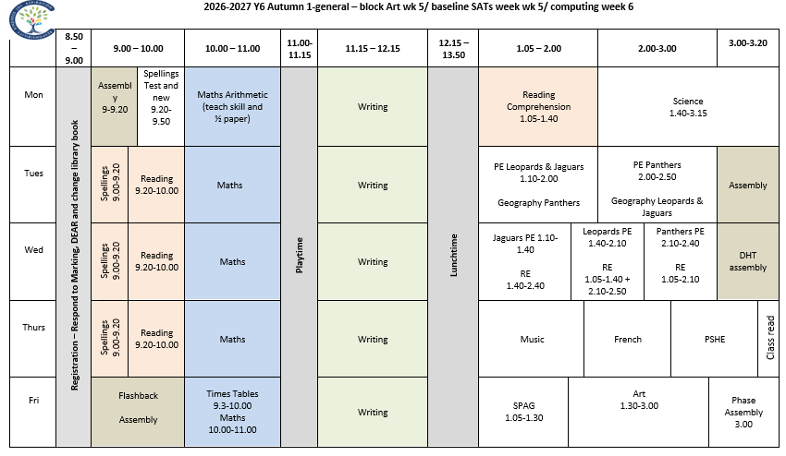
Typical Year 6 Timetable
Notes:
Sarah

Slide 14
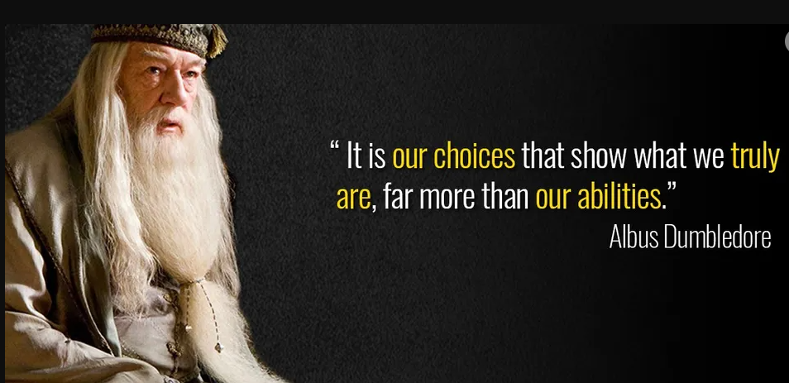
Our expectations
Within the school, Year 6 are role models for the younger children and we will be expecting them to conduct themselves as such in line with our core values.

Slide 15
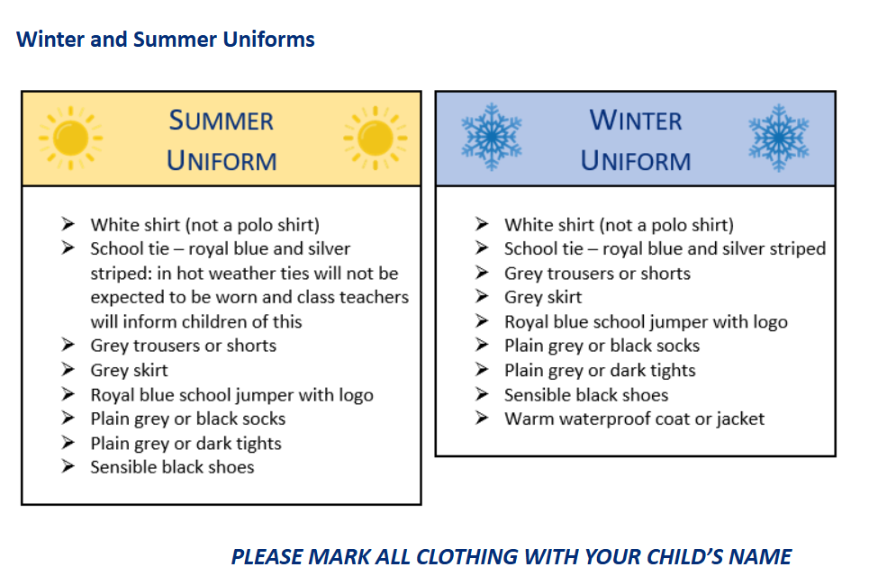
Uniform
Now the children are the top of the school, we will be really emphasising the importance of wearing the correct uniform in Year 6. This is important at secondary school, too.

Slide 16
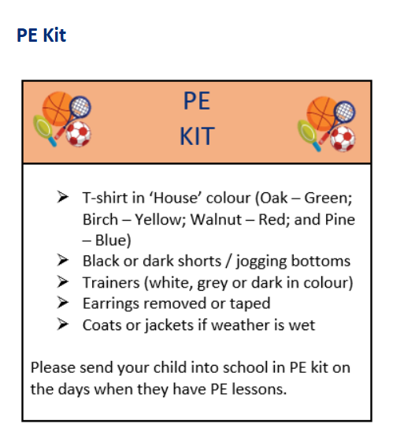
Please make sure your child also has an appropriate coat in school for the cold and wet days as we will still be going outside as much as possible. They also need a water bottle in school everyday.

Slide 17
Jewellery and Hair
To adhere to health and safety guidelines, children who have their ears pierced should only be wearing studs in school. No other earring types should be worn as they represent a risk. During PE lessons, children need to be able to take out their studs and put them back in at the end of the lessons. If they are unable to do so, they will need to put tape over the studs.
No other jewellery should be worn at school unless it is of a religious or medical significance. Please inform your child’s teacher if this is the case.
All children with long hair should wear it tied or clipped back for school. This is, again, to adhere to health and safety guidance and to prevent any possible spread of head lice. Any hair accessories should be discreet and minimal. Extreme hair styles (dyed hair, tramlines, Mohicans etc.) are not permitted.

Slide 18
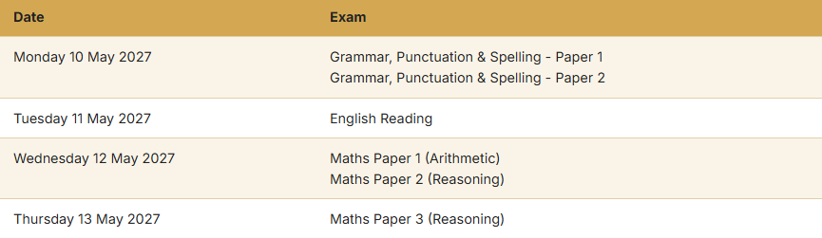
SATs Tests:
At the end of Key Stage 2, your child will take national curriculum tests in English reading, English grammar and spelling and mathematics.
The test help measure the progress pupils have made and identify if they need additional support in a certain area. The tests are also used to assess schools’ performance and to produce national performance data.
In January, we will hold an information evening regarding SATs for parents to attend.

Slide 19

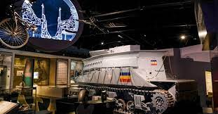
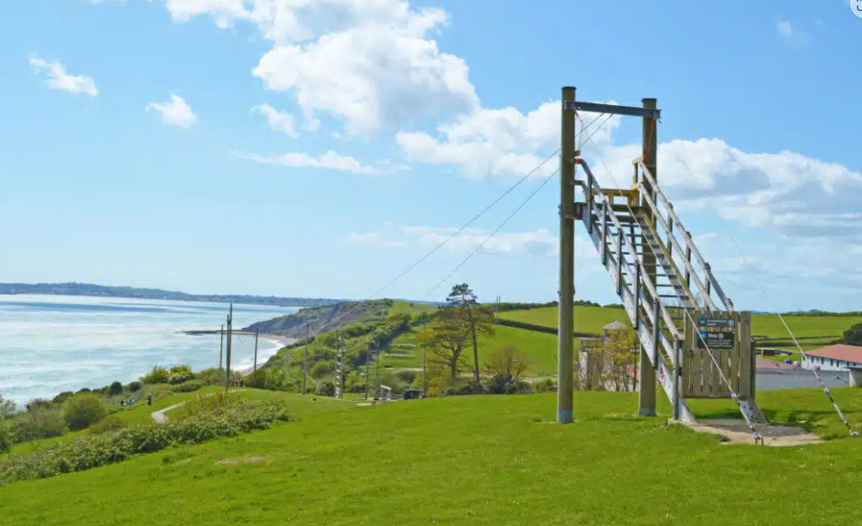
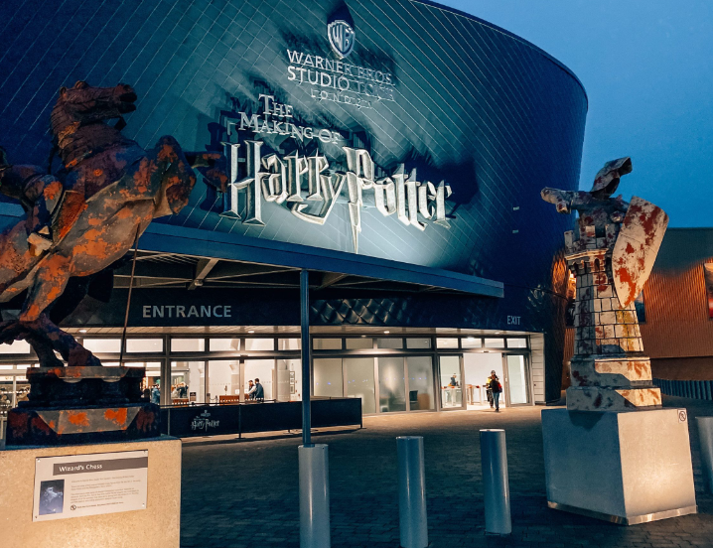
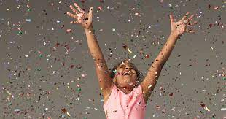
Trips & Visitors
D-Day Museum February
Osmington Bay - June
Liberty’s Owl and Raptor Centre – March
End of year celebration Harry Potter Studios –
June
Class Assemblies
Leopards – 19th November
Panthers – 14th January
Jaguars – 15th April
Notes:
Sarah

Slide 20
Communication
If you need to contact your child’s teacher, please send an email via the school office and we will get back to you as soon as we can.
Please don’t hesitate to catch us at the beginning or end of the school day if you have any non-urgent queries.
Please be assured we will contact you urgently if we have any concerns about your child.

Slide 21
A fantastic year!
The children have all made a brilliant start to Year 6 and we are delighted with how well they have settled.
We have some really exciting topics to cover this year and we are sure that they will all have a fantastic Year 6 and final year at Cupernham.

Slide 22
Any Questions?
Please come and see the classrooms and introduce yourselves.
Thank you for coming!

